Slide 1

GAME
DEVELOPMENT
PRESENTED BY
RINSU REGI
ATHULYA S
GREESHMA MERIN
RESHMA K PILLAI

Slide 2



RODICS

Slide 3

RODIC

Slide 4


Slide 5


Slide 6


Slide 7


Slide 8


Slide 9


Slide 10
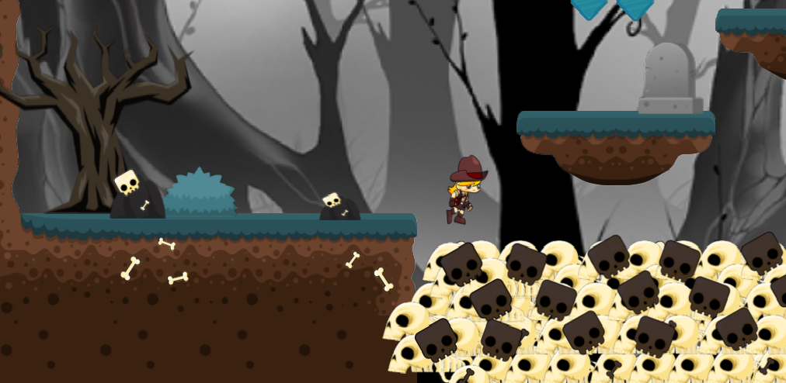

Slide 11


